Slide 1
Geoprocessing

Slide 2
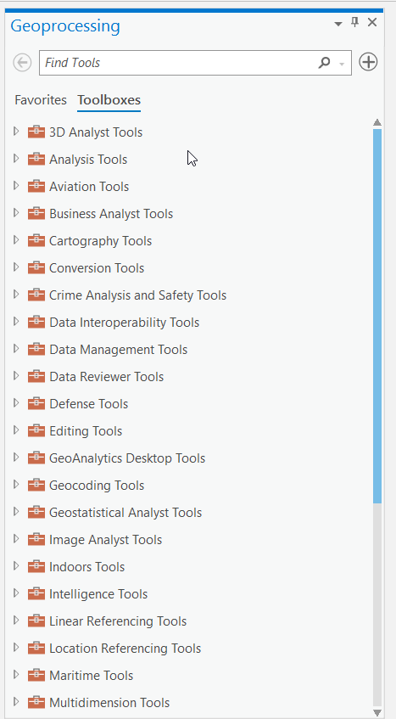
Basic Geoprocesing
We are only going to look at some of the basic tools found in your Analysis Ribbon
Each tool has a help document and we will be using the pptx file which has all of the data pre loaded

Slide 3
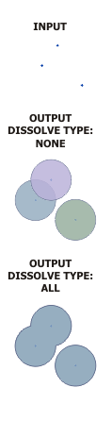
Buffer
We are first going to do a simple point buffer
For this we are going to use the day care centers and we are going to do a 100 foot buffer around them
This gives a visual representation of the buffer and can be used for further analysis

Slide 4
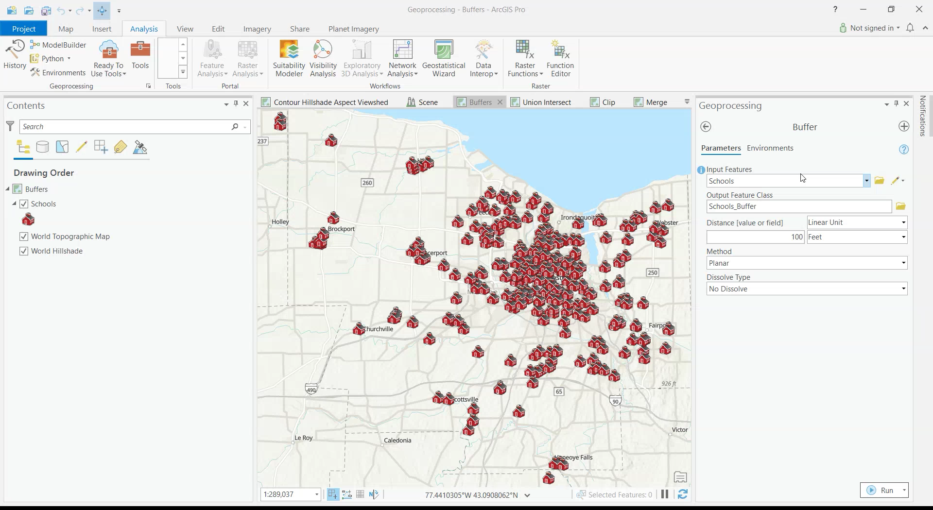
Buffer

Slide 5
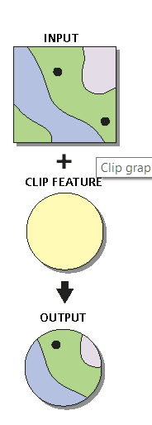
Clip
Clip extracts only a part of a dataset against a clip feature (cookie cutter)
You will get what ever falls within the area
We will explore the tool using the NYS Centerlines and Monroe County Town and Villages

Slide 6
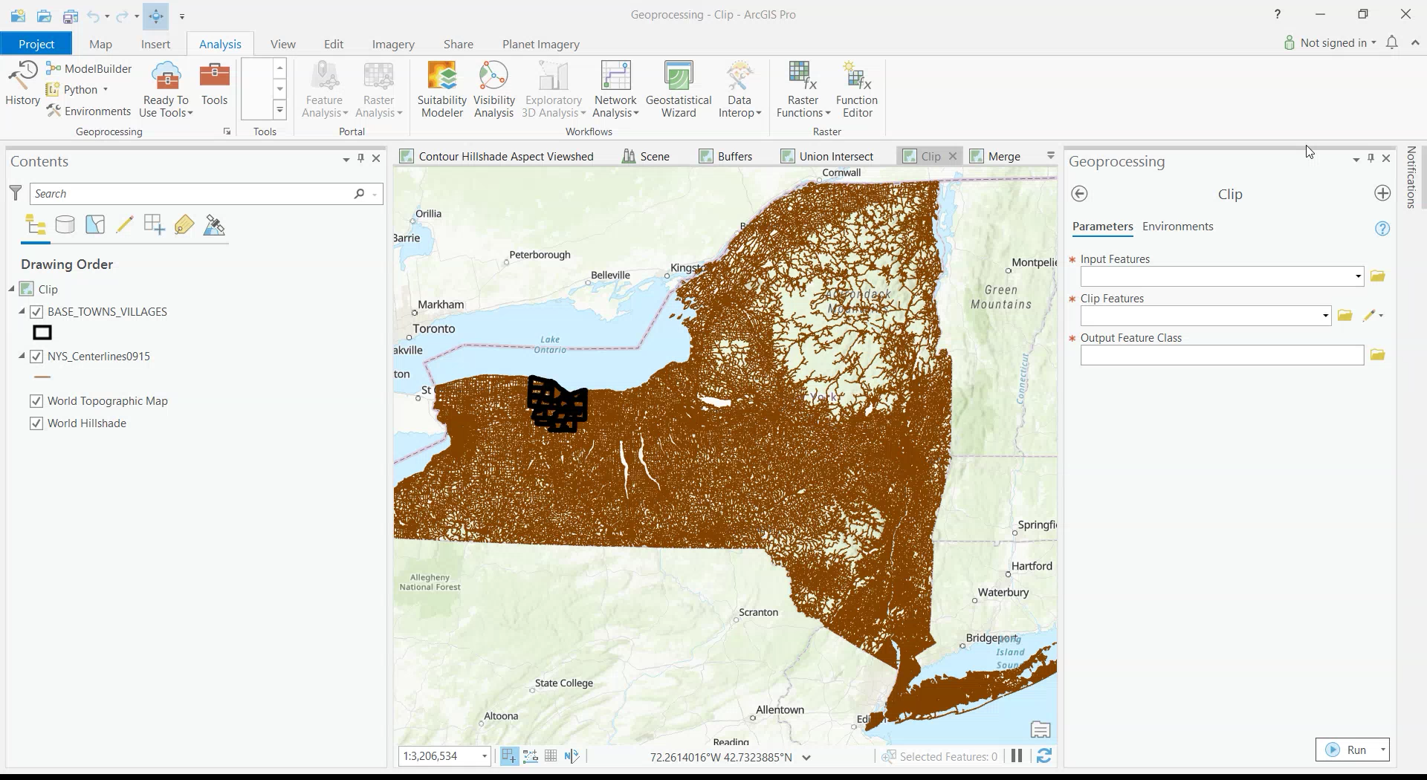
Clip

Slide 7
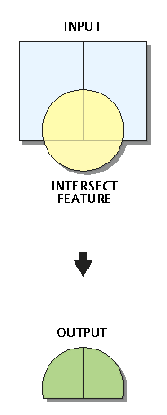
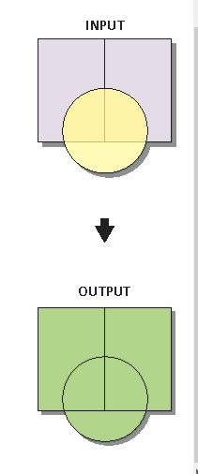
Intersect and Union
Intersect
Union
Intersect and Union take two similar features and combine them together.
Intersect only keeps the like parts
Union keeps all parts but cuts them where they are different
We will explore these using the wetland layers

Slide 8
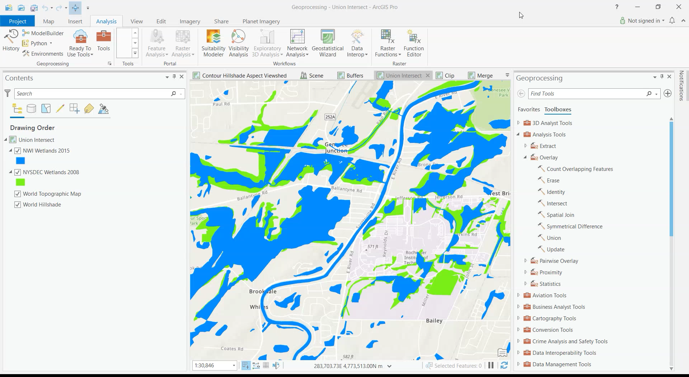
Intersect and Union

Slide 9
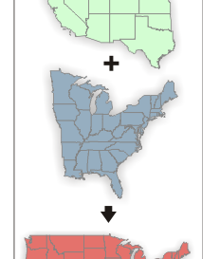
Merge
Merge takes two or more layers and combines them
It differs from Union and Intersect, because it just combines them without analyzing the geometry for likes
It works well for combining tiled datasets with the same attribute schema
We will just play with the wetlands and this layer to see how it reacts

Slide 10
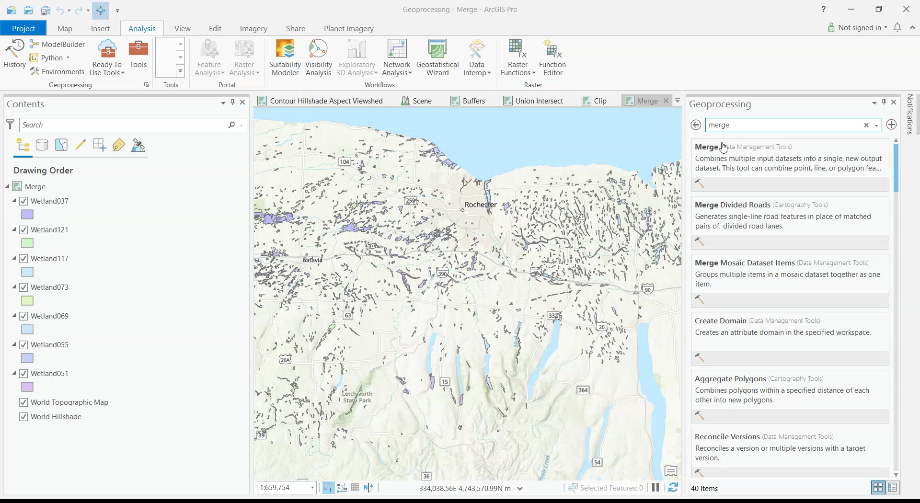
Merge

Slide 11
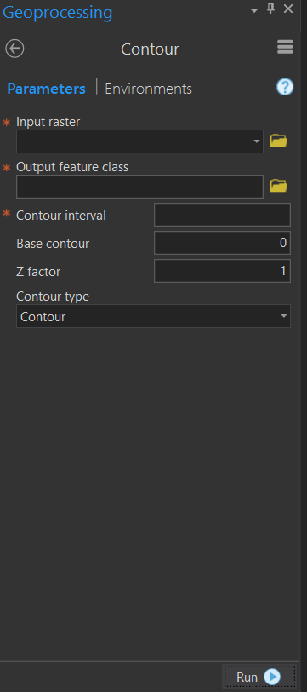
Contours
Contours are a good way to represent raster data in a vector form
Contours are based on your manual interval and will draw lines between each pixel

Slide 12
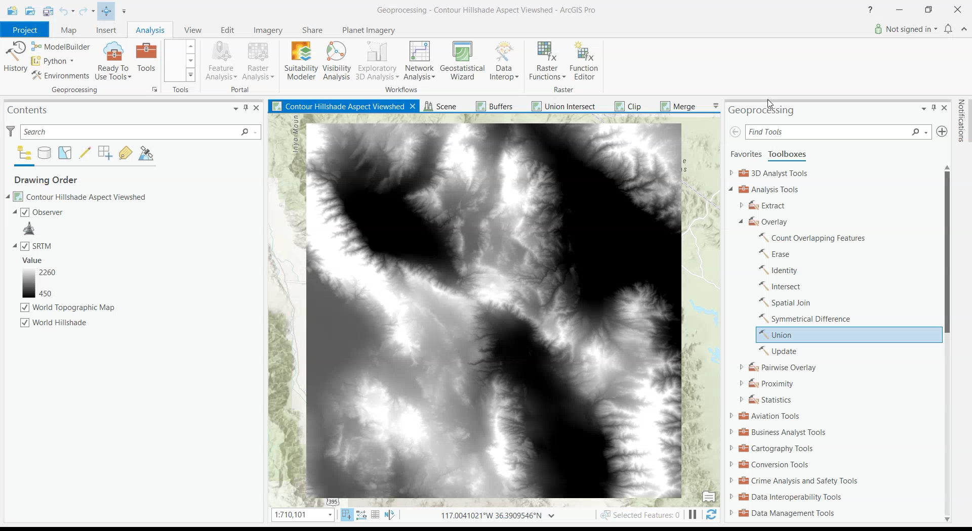
Contour

Slide 13
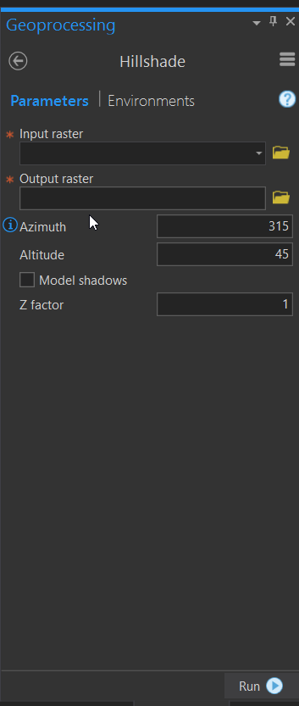
Hillshade
Hillshades are great way for a 3D feel in your map
It takes an elevation dataset and then estimates the shadows on the surface
You can adjust the sun to change the effect

Slide 14
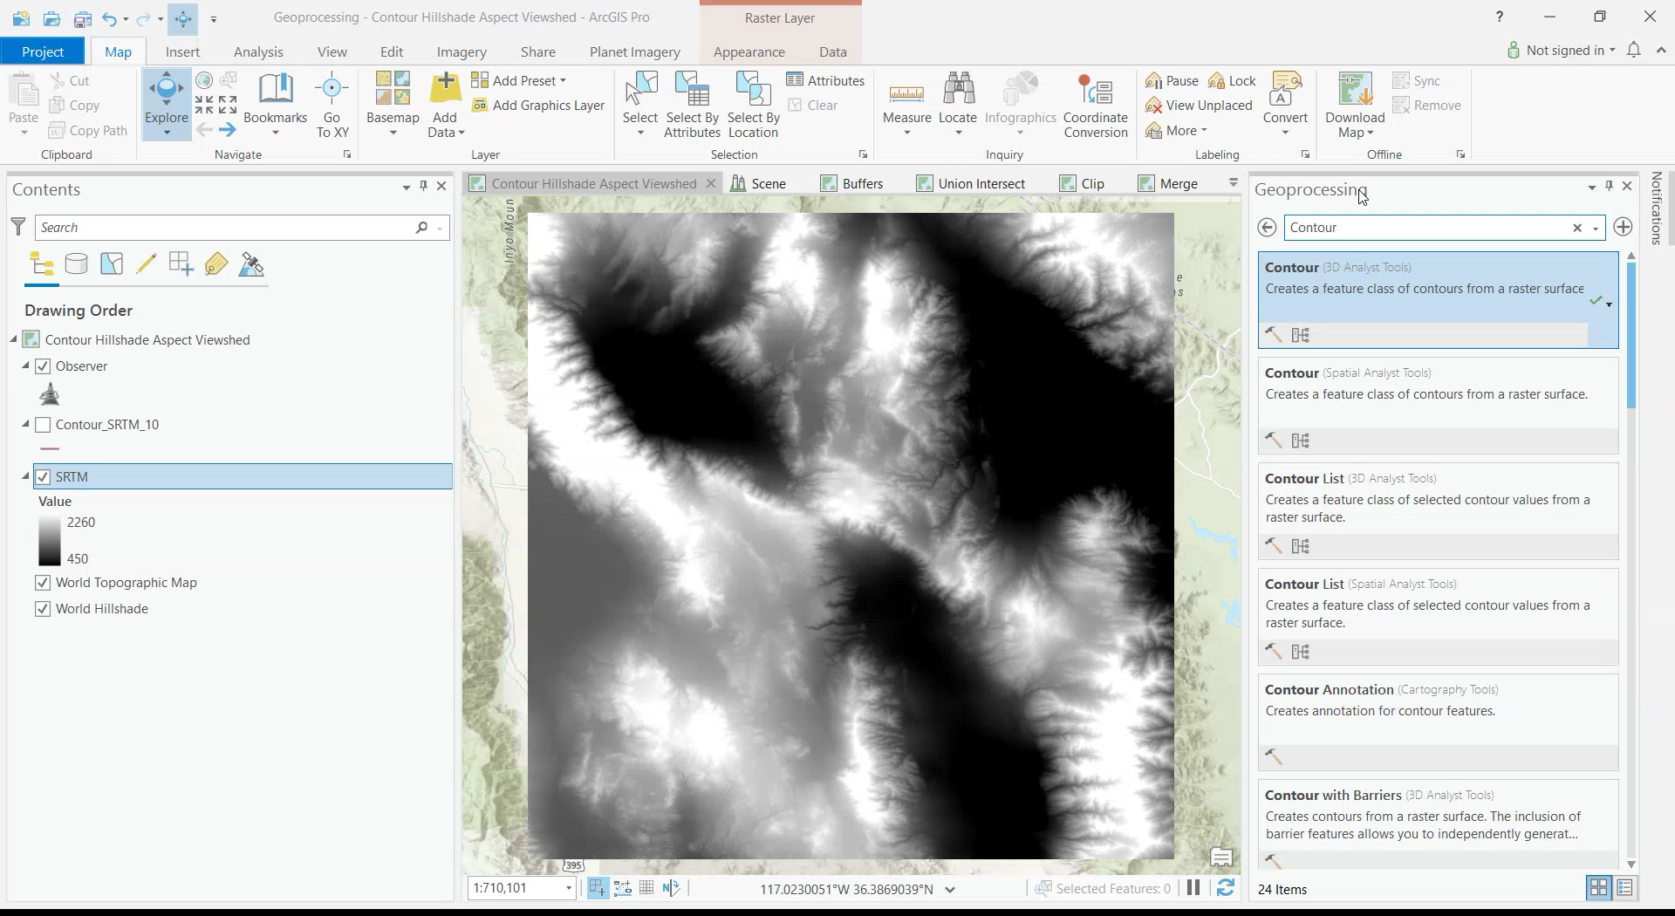
Hillshade

Slide 15
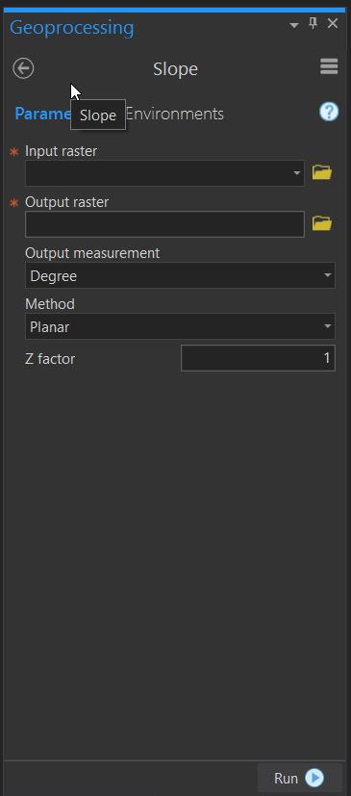
Slope
Slopes are great for looking at the change in elevation over a set distance

Slide 16
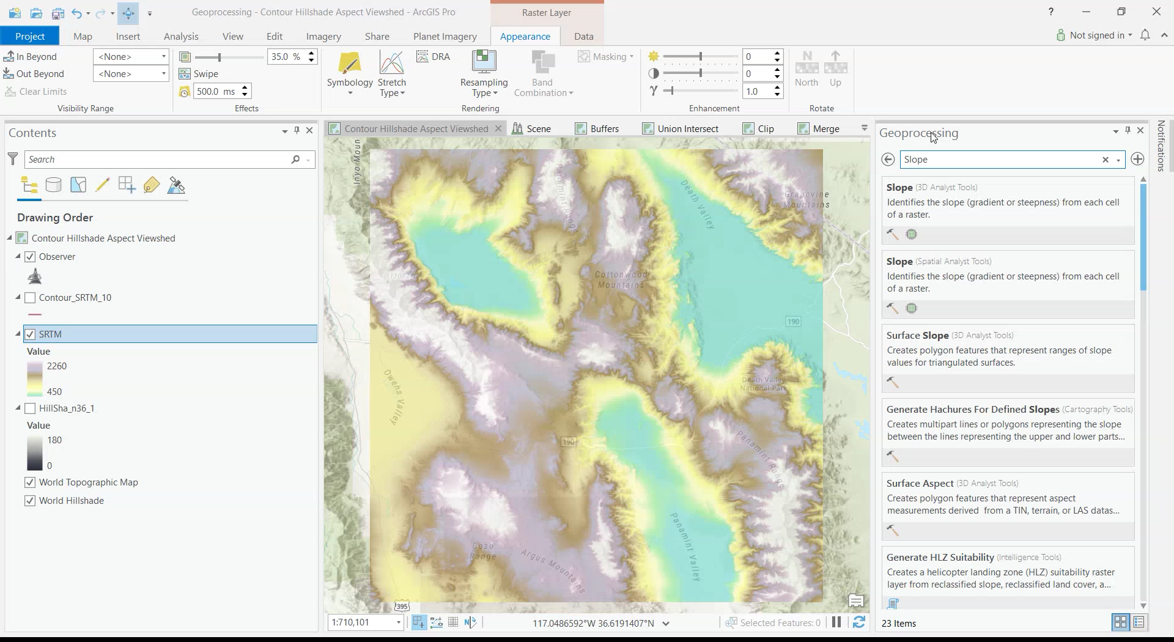
Slope

Slide 17
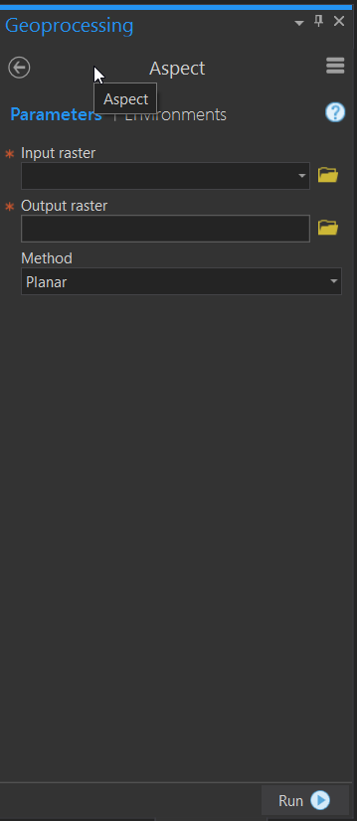
Aspect
The Aspect of an elevation is which direction the edge is facing
This is a great tool for looking for solar energy potential of a site

Slide 18
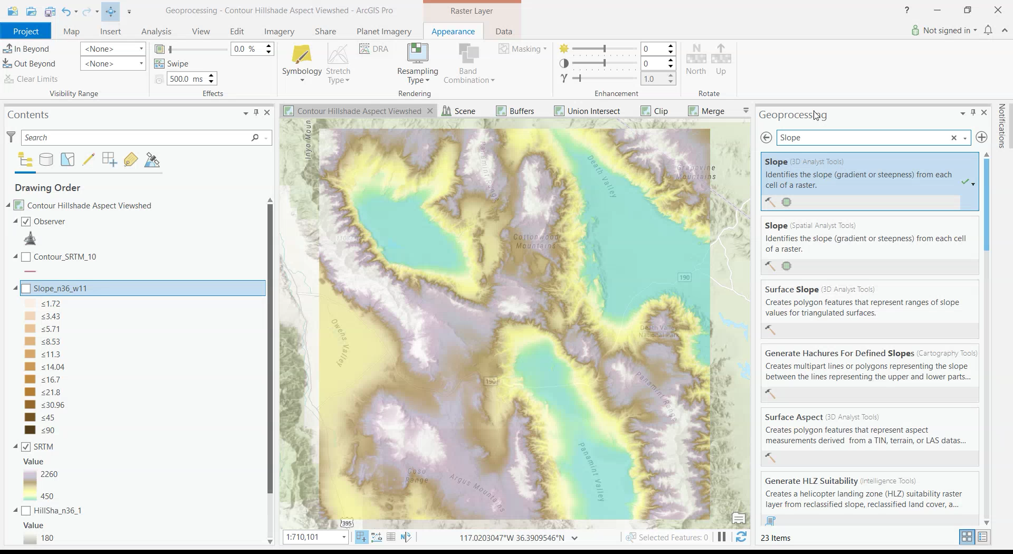
Aspect

Slide 19
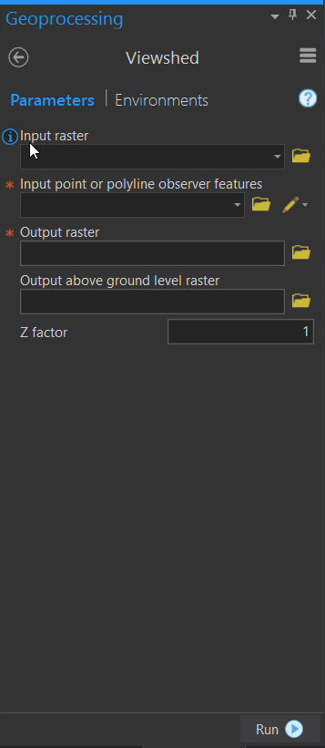
Viewshed
Viewshed is basically where you can see a point on a landscape.
It takes an observer feature
Then it creates a yes no raster for visibility

Slide 20
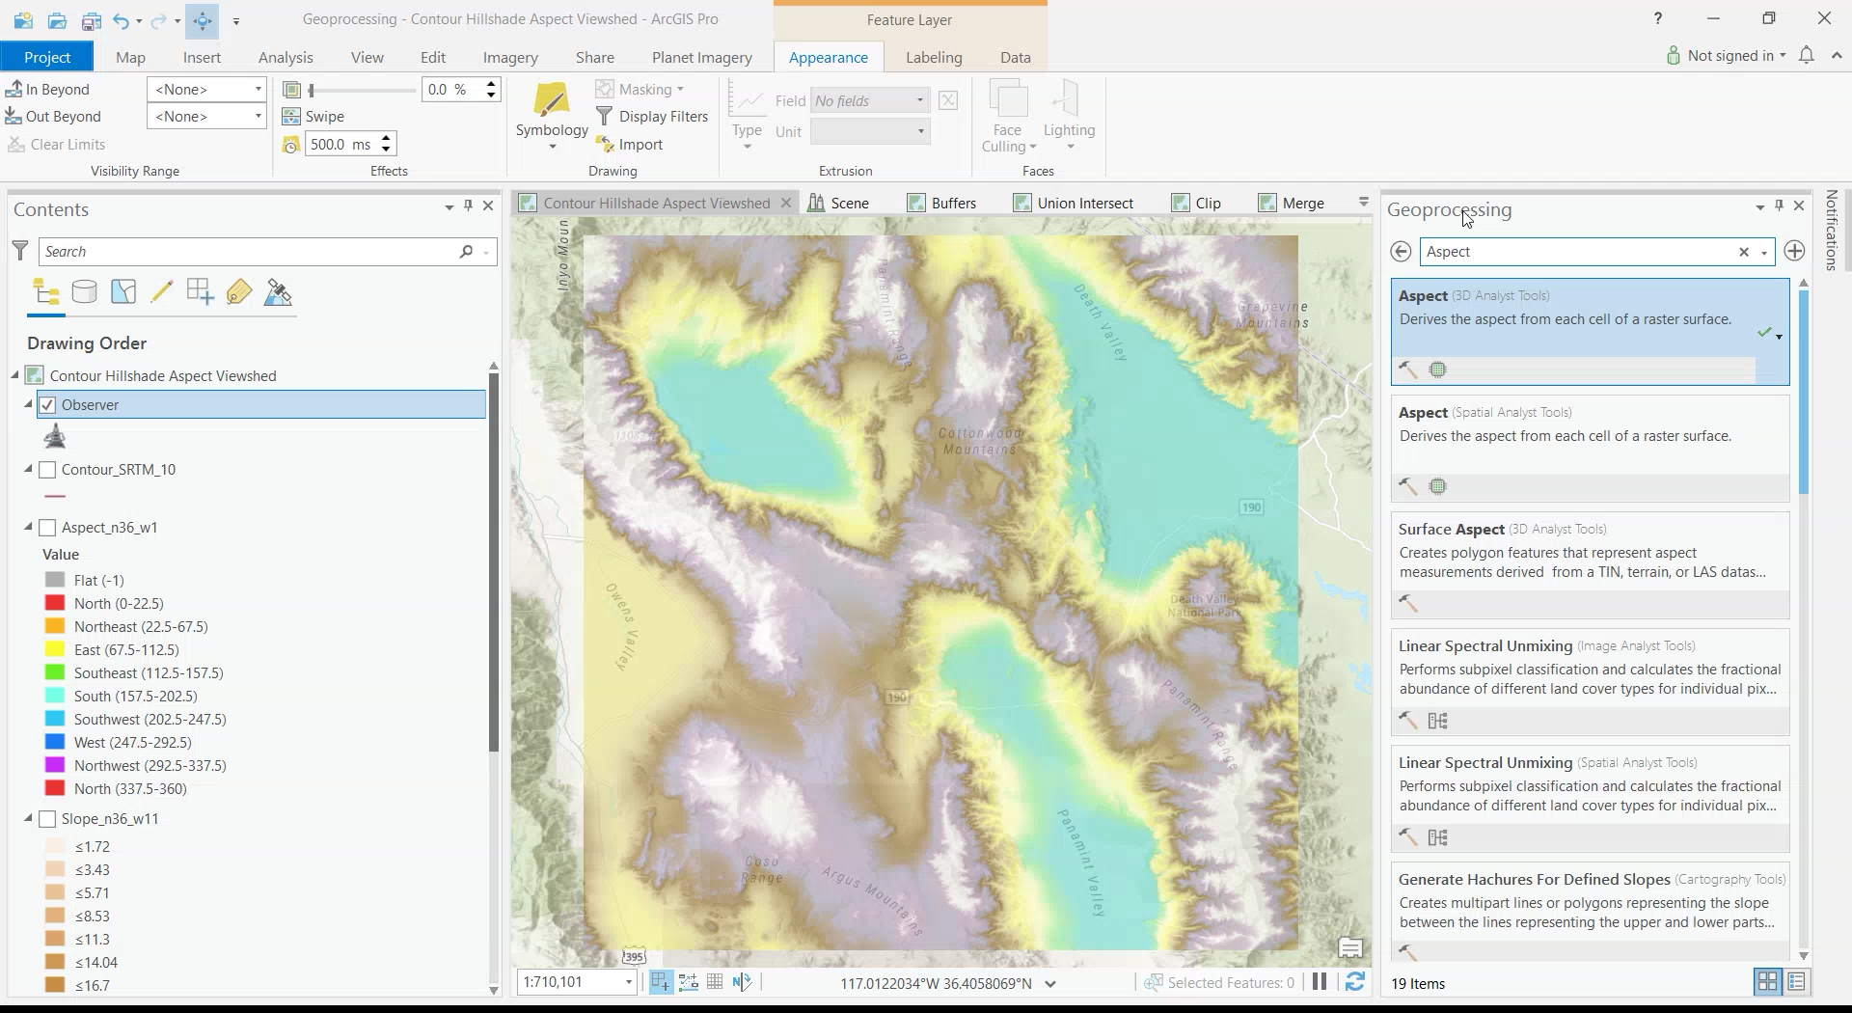
Viewshed

Slide 21
Python

Slide 22
What is Python
Open Source Programming Language
Named After Monty Python
Comes Installed in ArcGIS
Allows you to automate geoprocesses, calculate string, and create new layers
In ArcGIS is it referred to as ArcPy

Slide 23
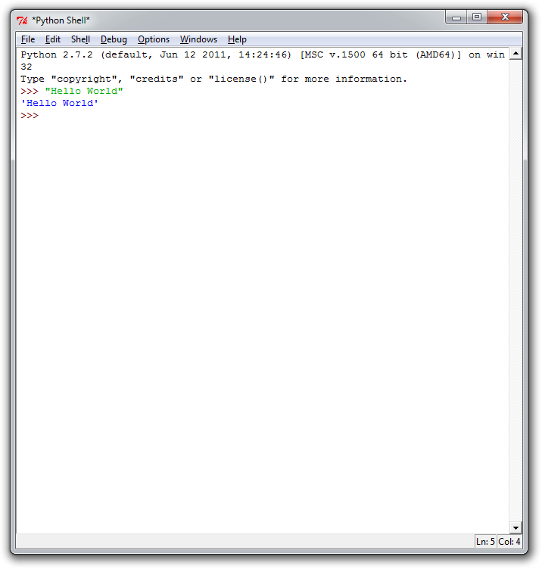
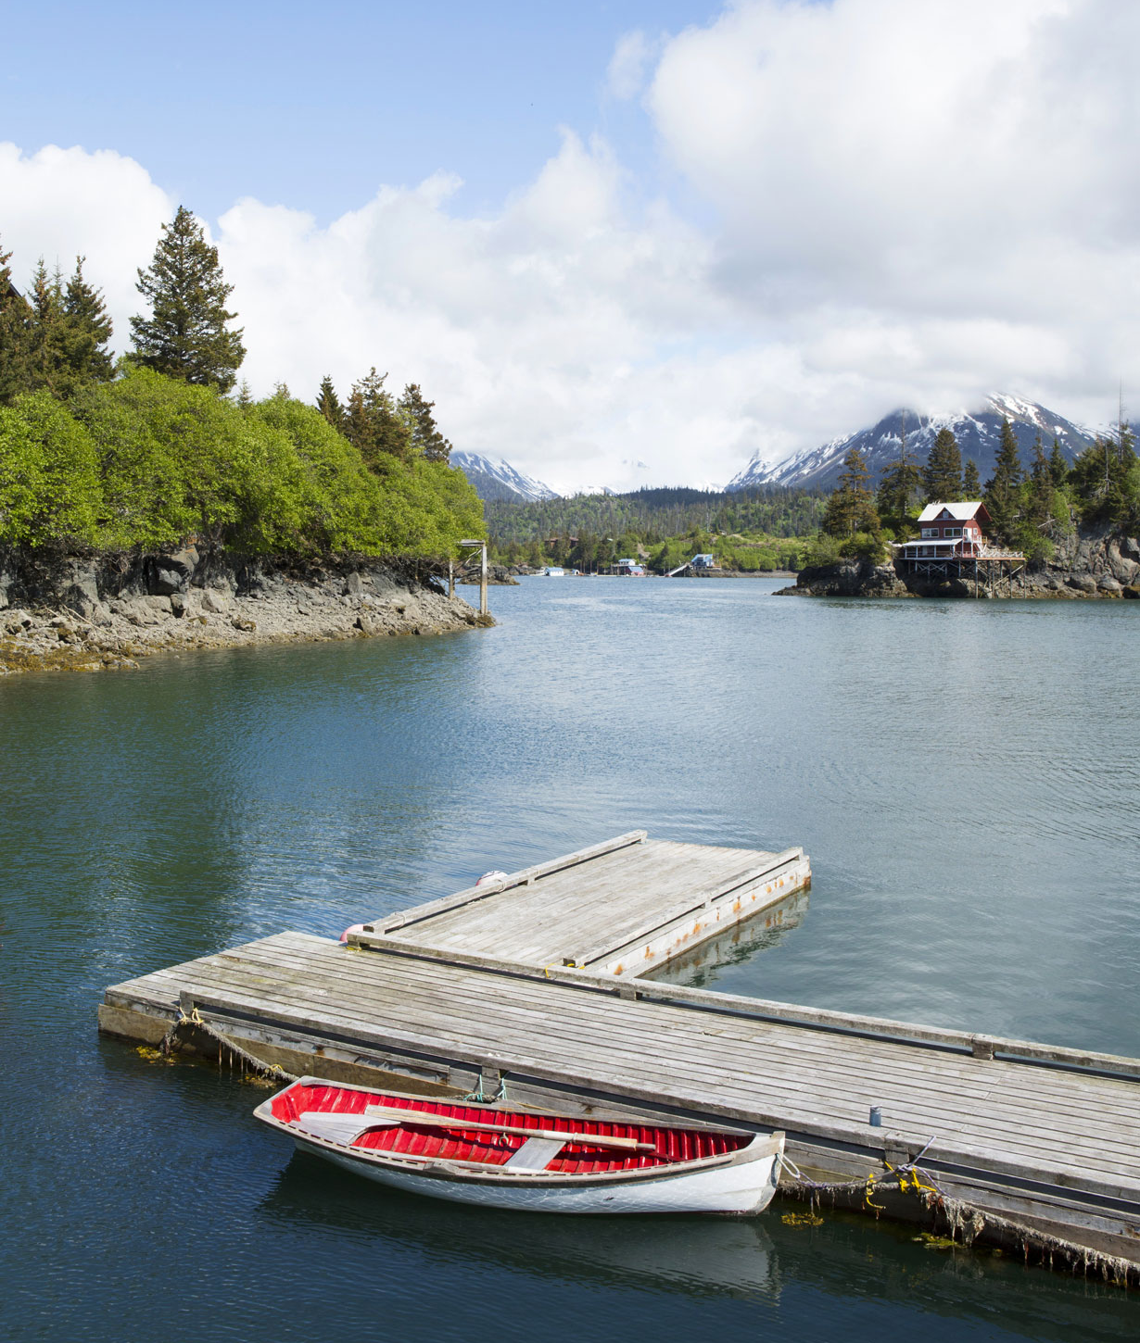
Python IDLE
Window within the ArcGIS Start Menu Folder
Allows you to do basic python commands
Single Line Entries
I like Notpad ++ to do my python editing

Slide 24
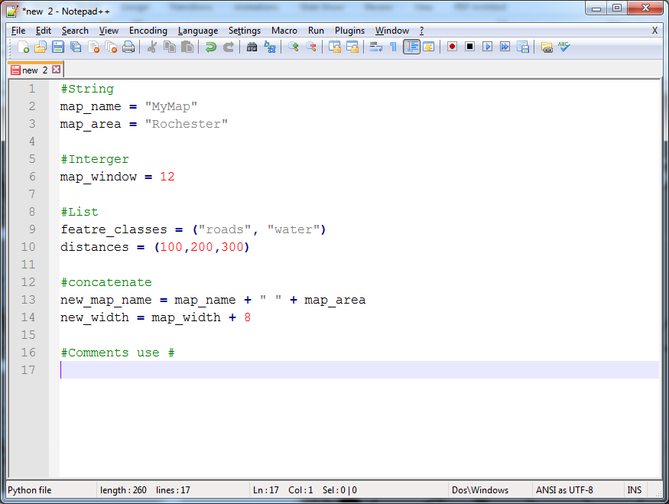
Basics of Python - Variables

Slide 25
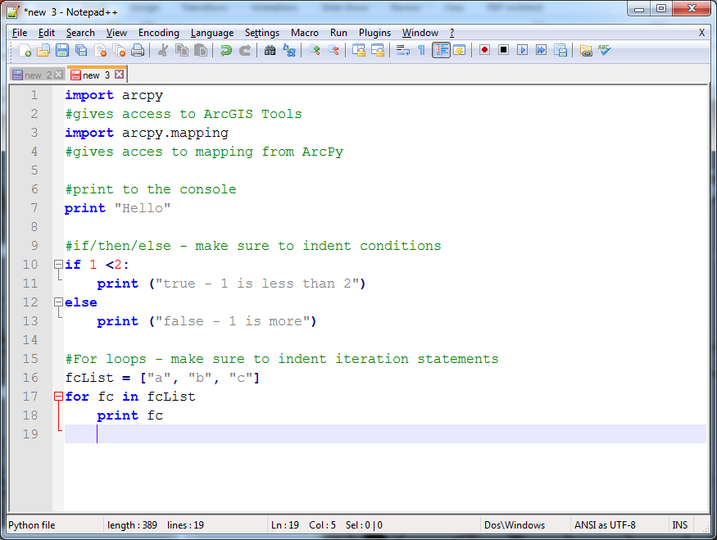
Basics of Python - Statements

Slide 26
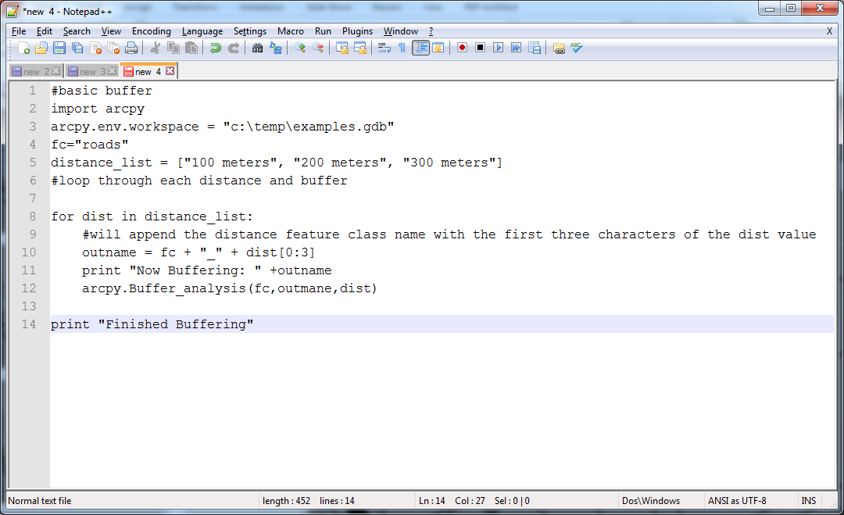
Basic Scripting

Slide 27
All Tools within Toolbox have Python Equivalents
http://pro.arcgis.com/en/pro-app/tool-reference/analysis/buffer.htm

Slide 28
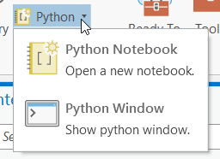
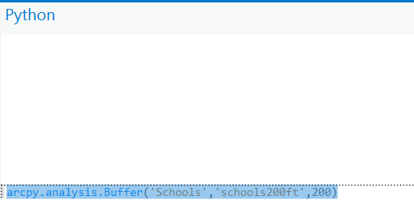
ArcPy Window
Simple method to get to python from ArcGIS
Start your command with arcpy
As you then work with a tool it will help you fill out the other parts of the tool
Once you finish it you can hit enter

Slide 29
Hands On ArcPy
We will now use the Geoprocessing PPK from week 10 and explore both Python and Model Builder
First we will do the buffer using ArcPy
arcpy.Buffer_analysis(‘Schools’, ‘School1000ft’,1000)

Slide 30
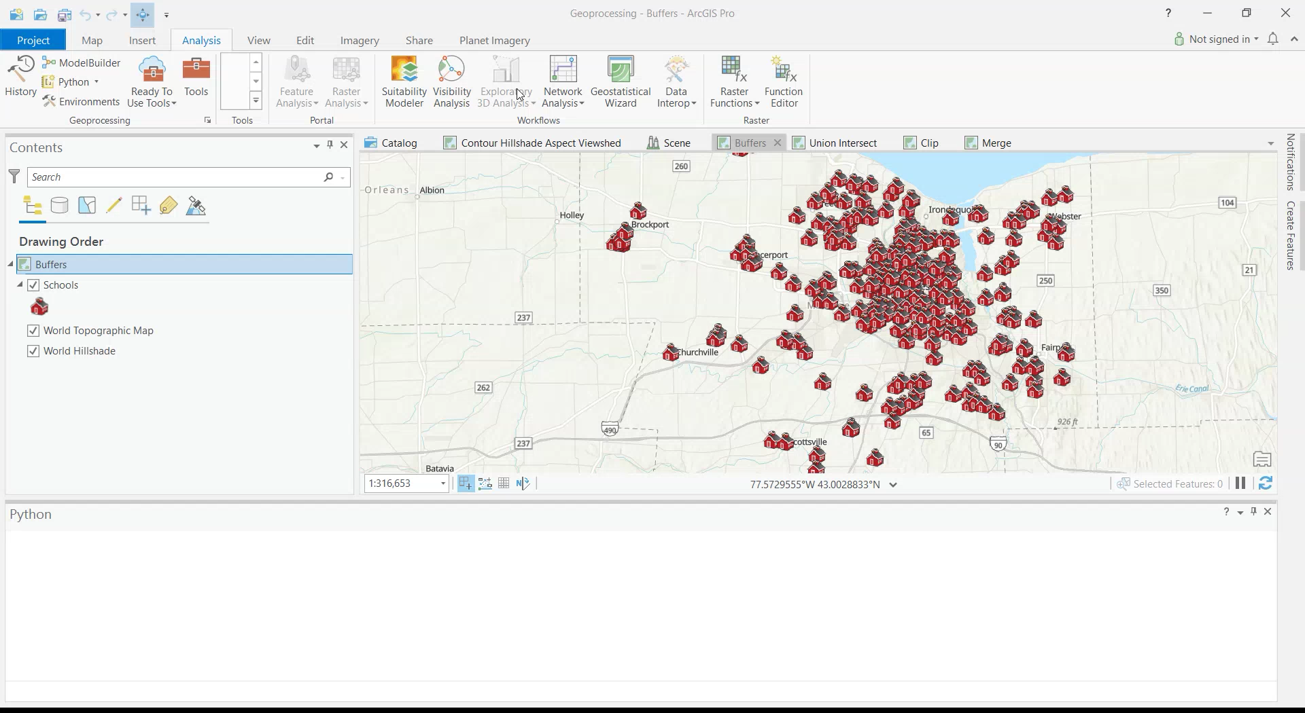
Python in ArcGIS Pro

Slide 31
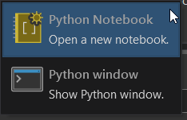
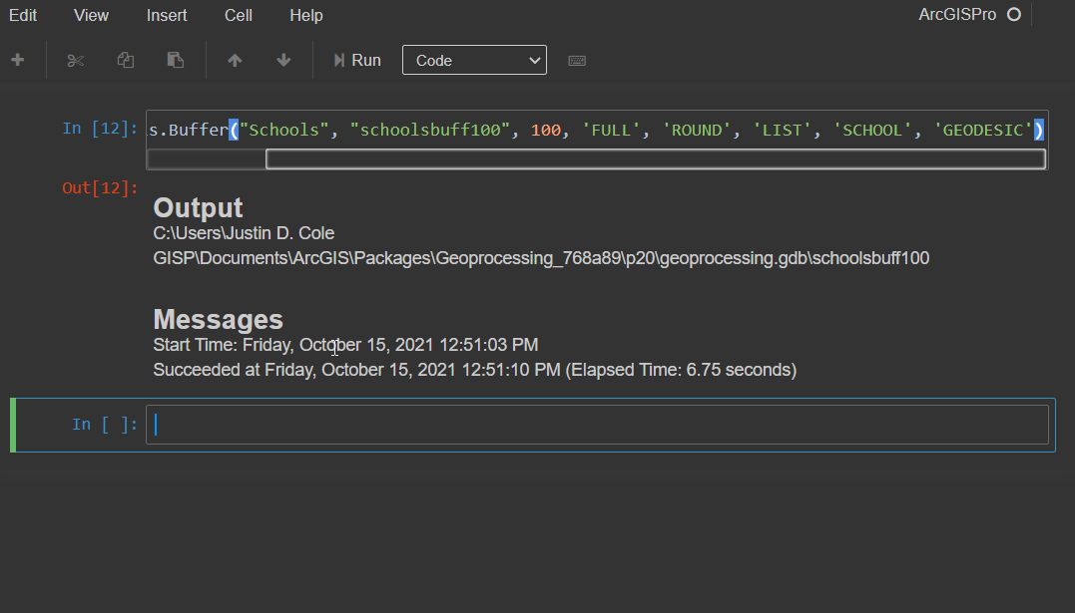
Jupyter/Python Notebooks
Another way to use python is through a notebook
Many people use these notebooks to document workflows and create processes
The utilize the same syntax as the python window

Slide 32
Model Builder
For those who are not programers there is model builder
It is visual programing environment within ArcGIS Pro
In Desktop you can even models export into Python

Slide 33
Hands on with Model Builder
We will now create a Basin model for the SRTM data
We will need the Fill, Flow Direction, and Basin Tools
We will also add the final raster to our map display

Slide 34
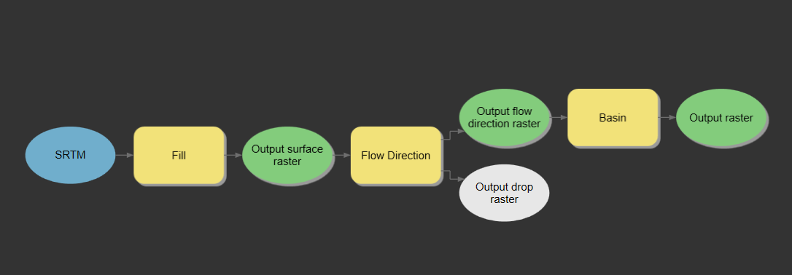
Hands on with Model Builder

Slide 35
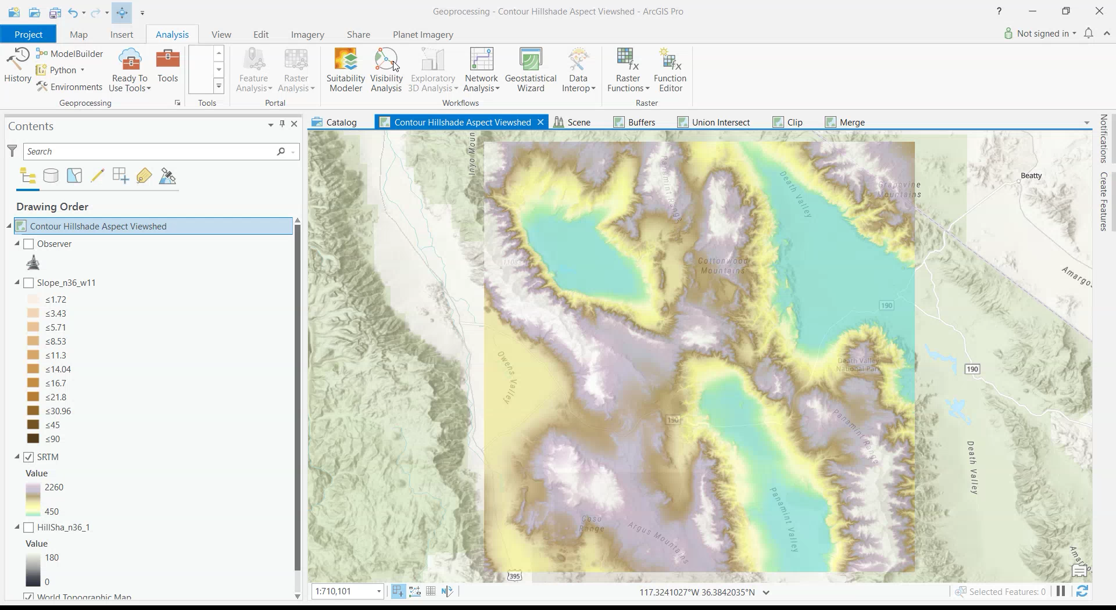
Model Builder

Slide 36
Discussion Assignment
Post a screenshot result from one of the tools in the discussion board for this week and an idea on how you would go about using it in your project

